Slide 1
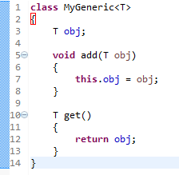
Generic class
A class that can refer to any type is known as generic class. Here, we are using T type parameter to create the generic class of specific type.
The T type indicates that it can refer to any type (like String, Integer, Employee etc.). The type you specify for the class, will be used to store and retrieve the data.
Type Parameters
The type parameters naming conventions are important to learn generics thoroughly. The commonly type parameters are here.
T - Type
E - Element
K - Key
N - Number
V - Value

